Slide 1
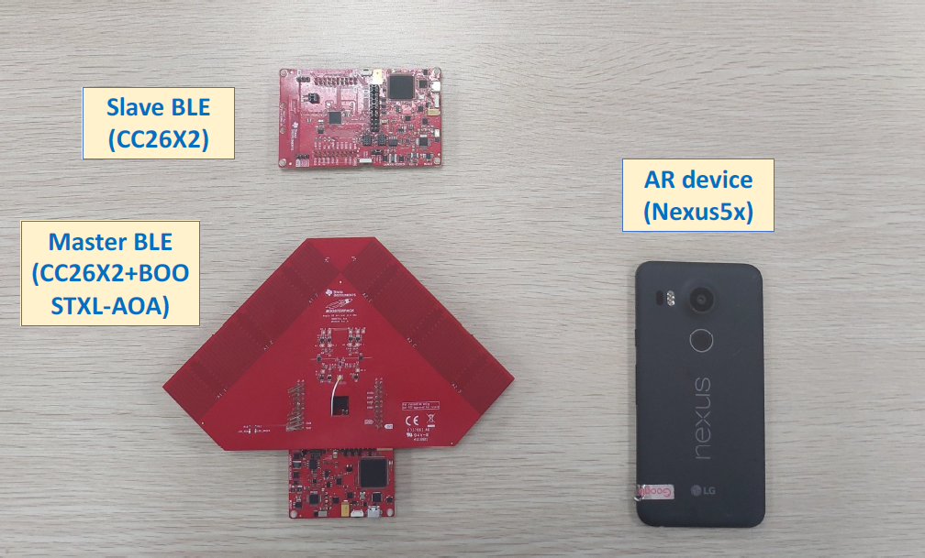
VisBLE
PROGRESS MEETING
21/03/2021

Slide 2
THINGS I WORKED ON….!
Handling the Multi-Slave Data.
3D Model for Antenna Board
Understanding the Camera Structure of the Mobile
Pixel Proximity Matching for Single Slave - Test
Pixel Proximity Matching for Multi Slave - Test

Slide 3

Handling Multi Slave,
Issue – Was not able to differentiate between multiple slaves when we collect data in the same time.
Importance – Using K-Nearest Neighbors Algorithm to sort out best points, Pixel calculation
As long as we receive acknowledgement from a slave, we have a connection handle assigned to it.
Using the connection handle as the mean to differentiate
Storing the Mapping in dictionary and use it for device indication

Slide 4
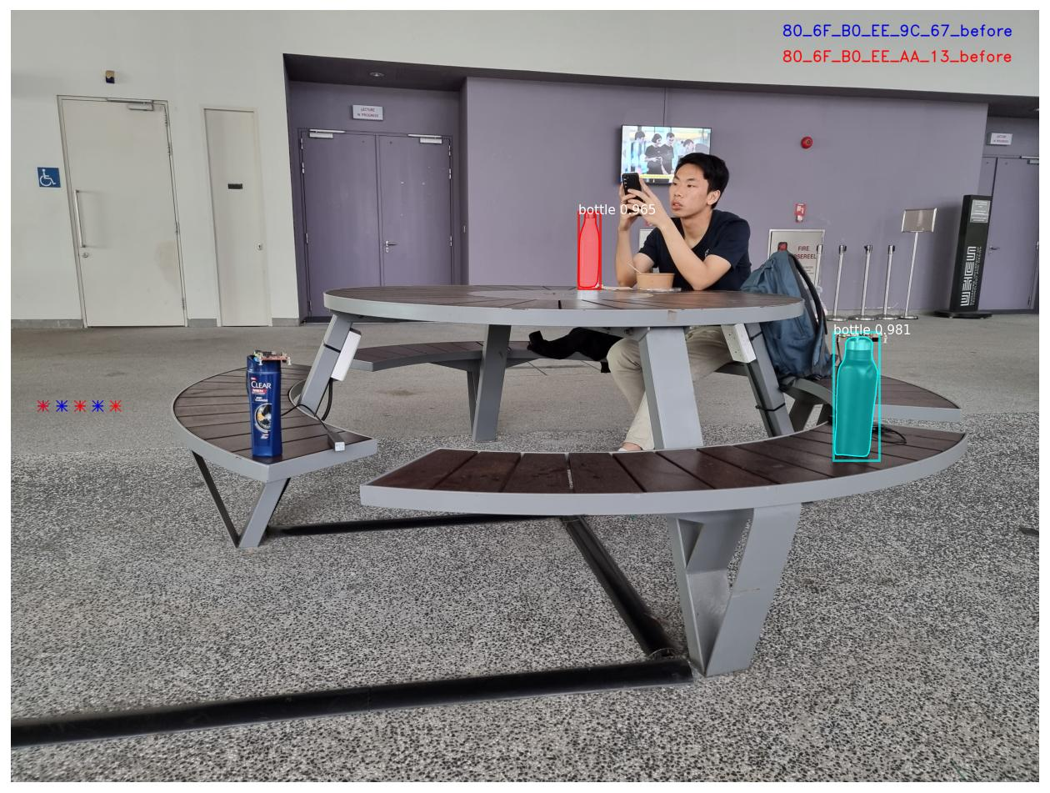
What you could expect,

Slide 5
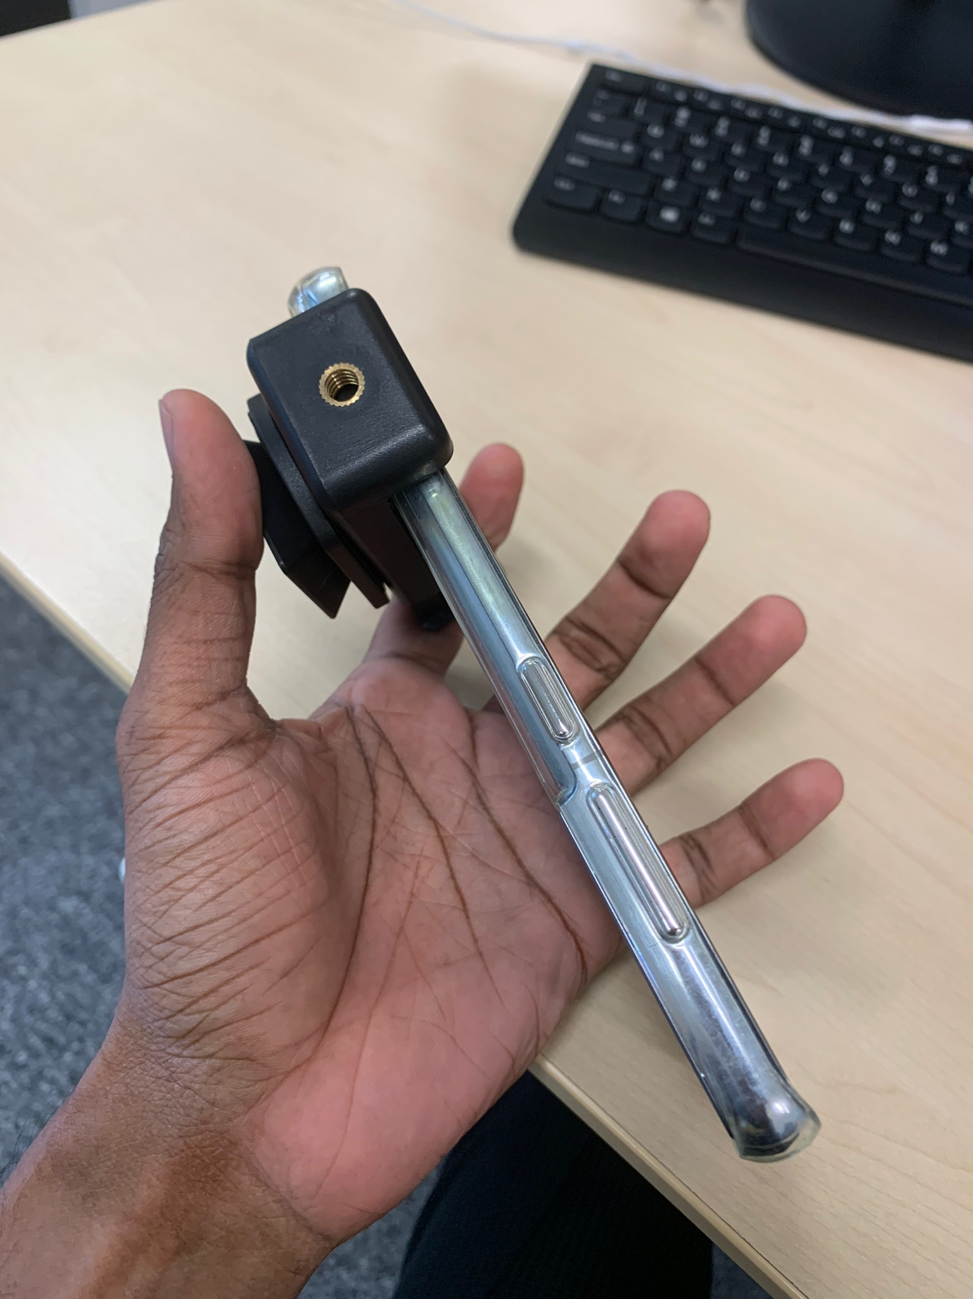
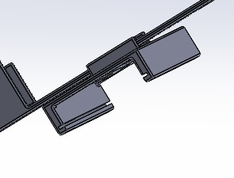
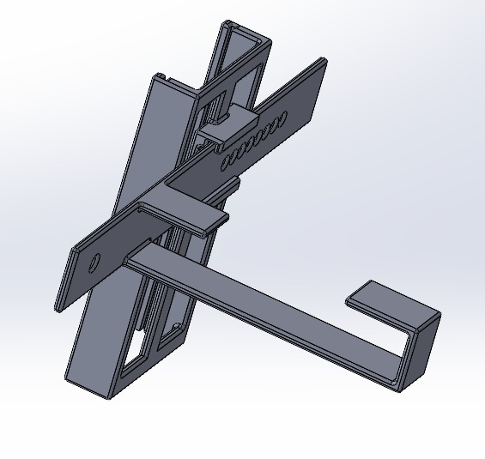
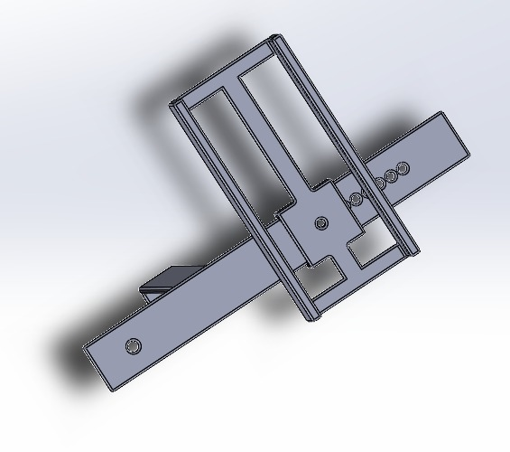
3D Model For Antenna Board,

Slide 6
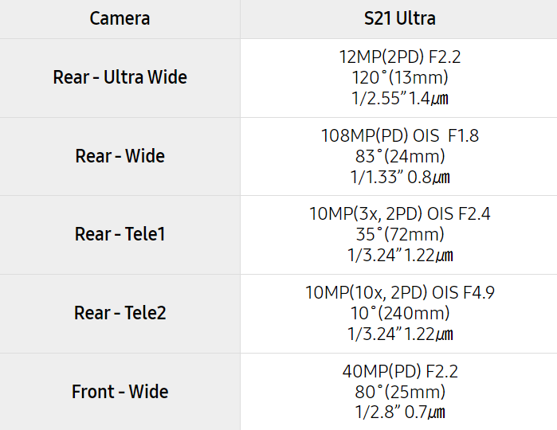
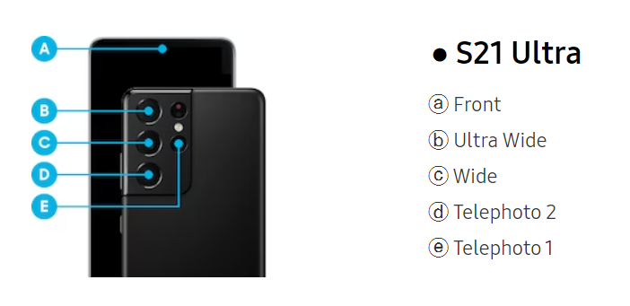
Understanding the Camera Structure,

Slide 7
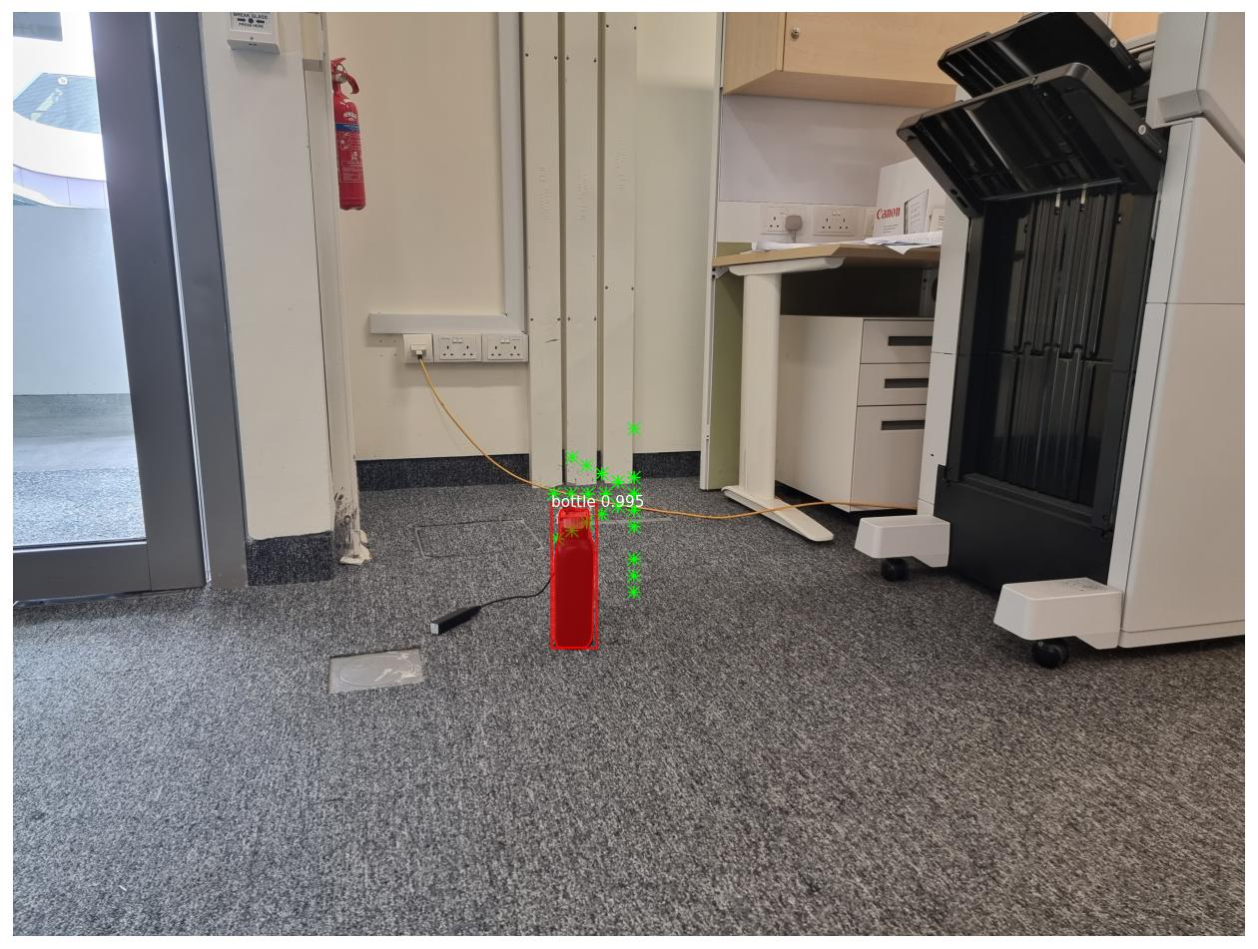
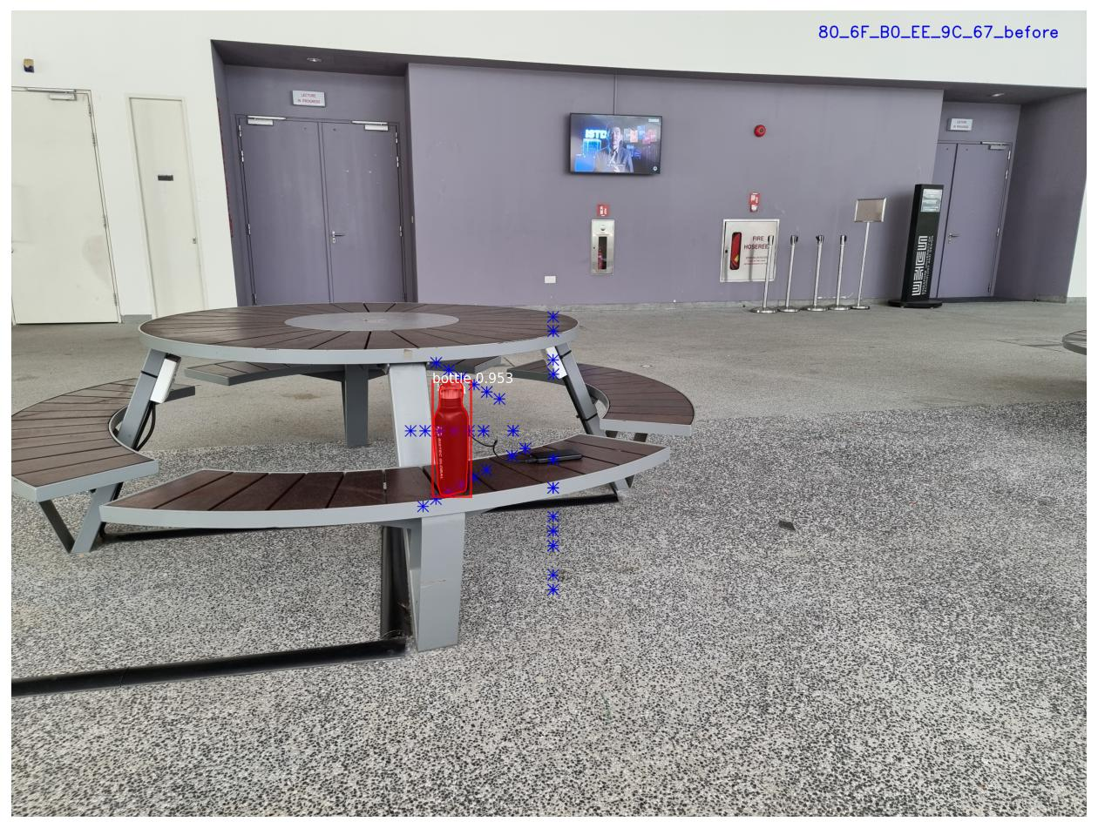
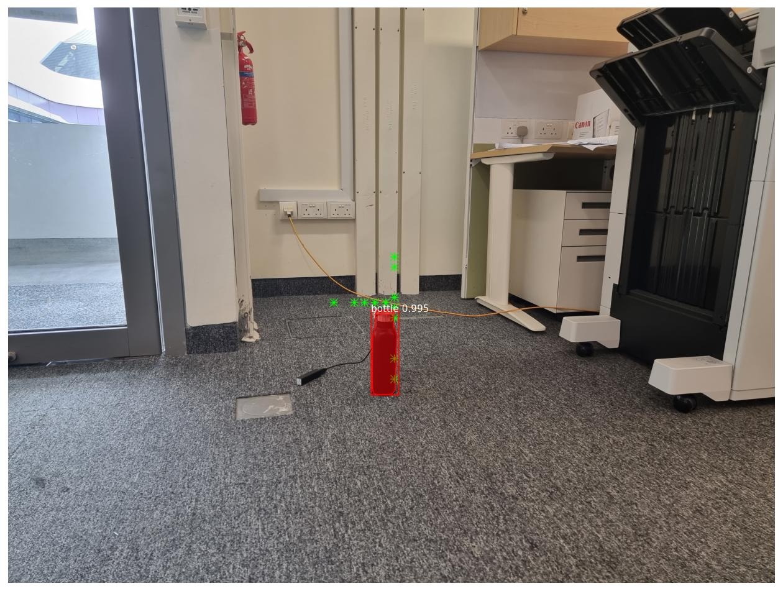
Pixel Proximity Matching Single Slave,

Slide 8
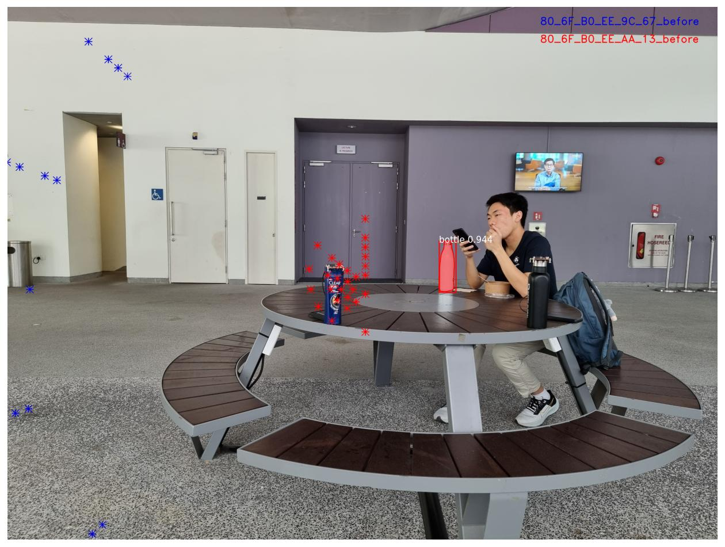
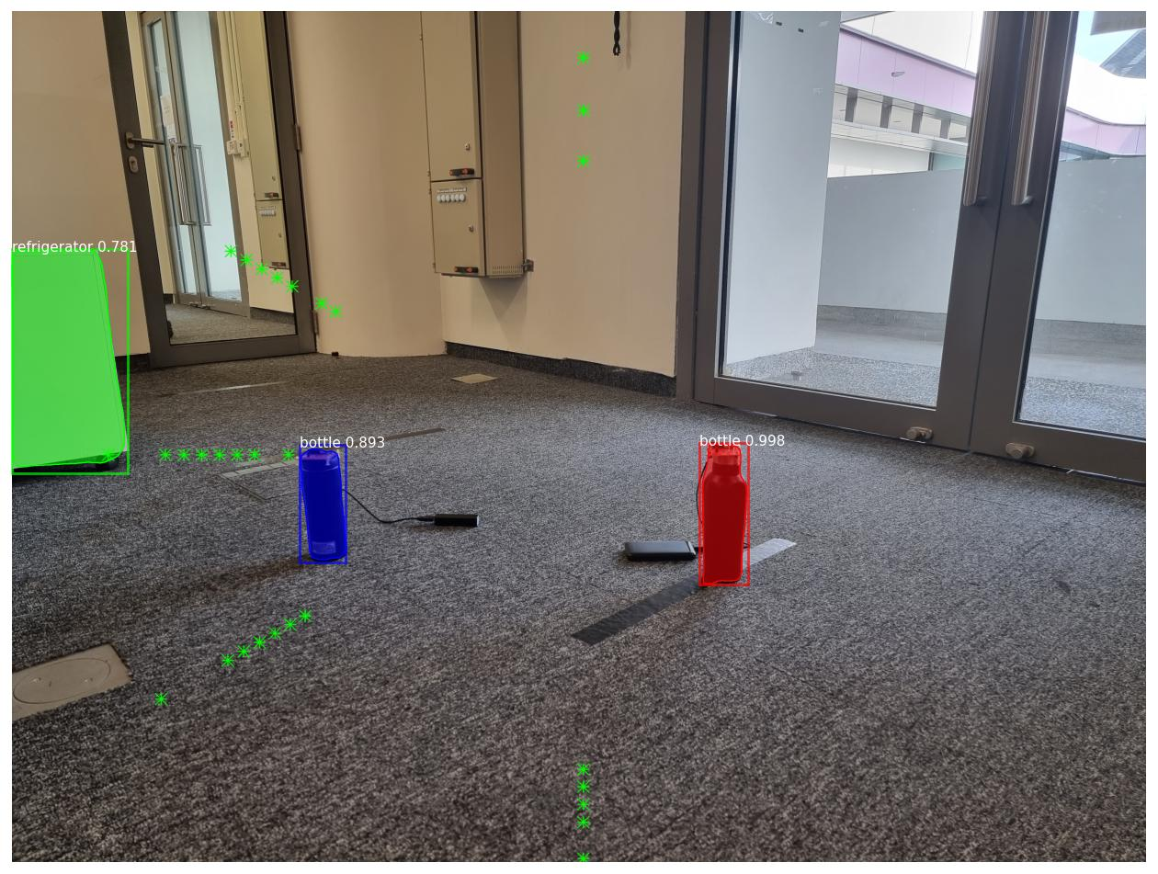
Pixel Proximity Matching Multi Slave,

Slide 9
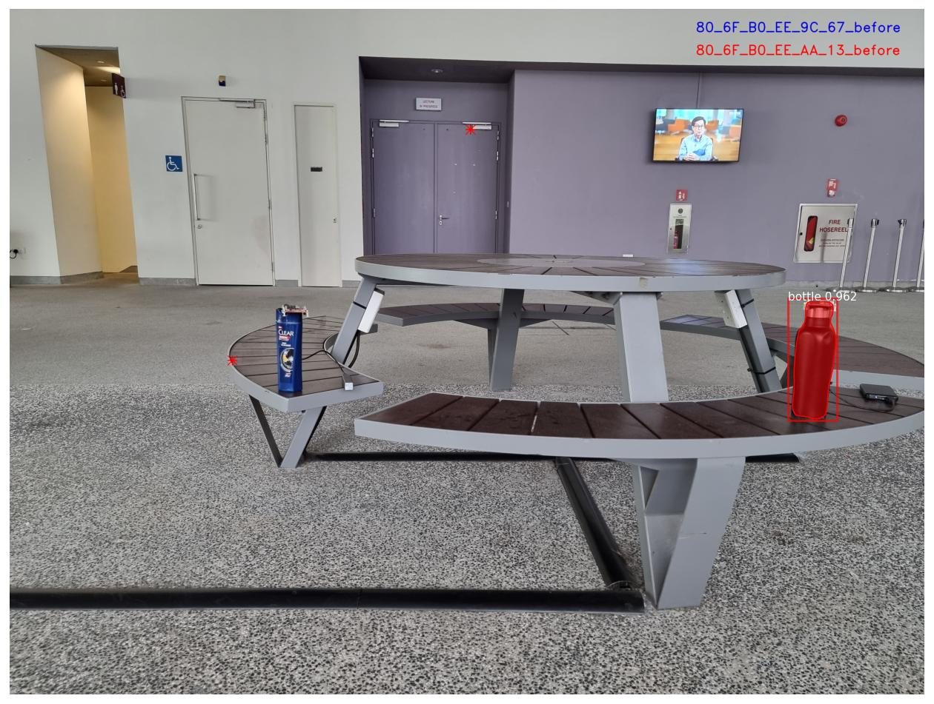

Slide 10
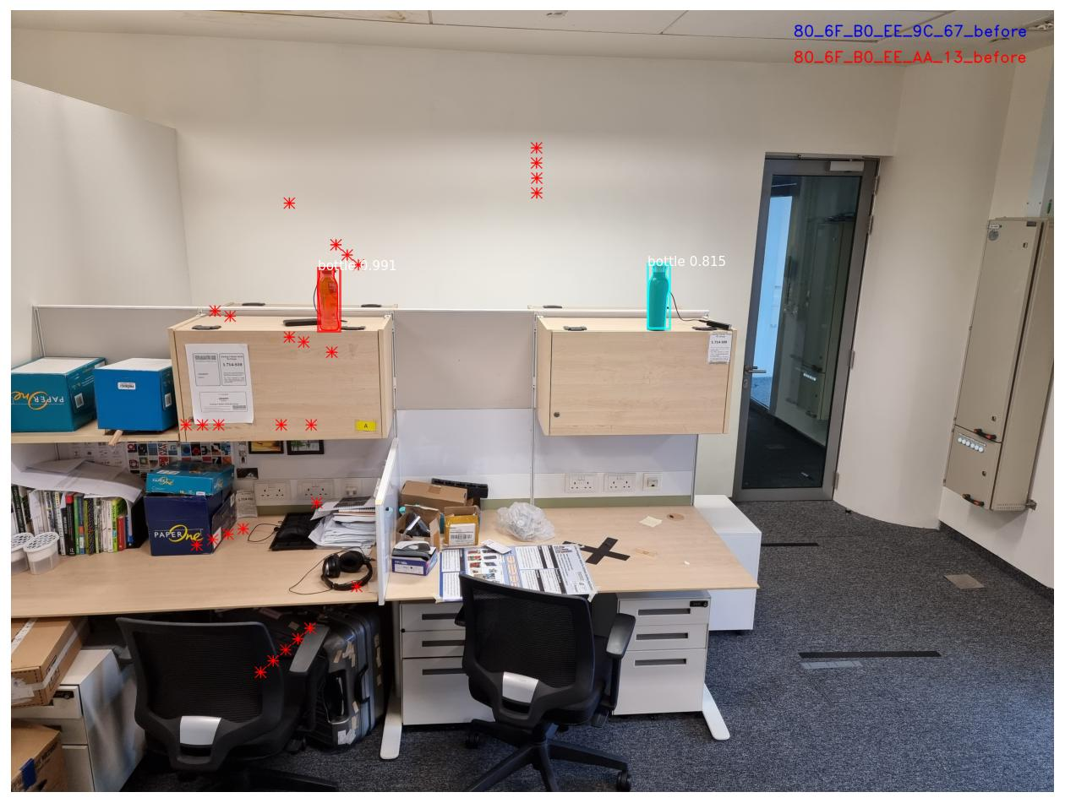

Slide 11
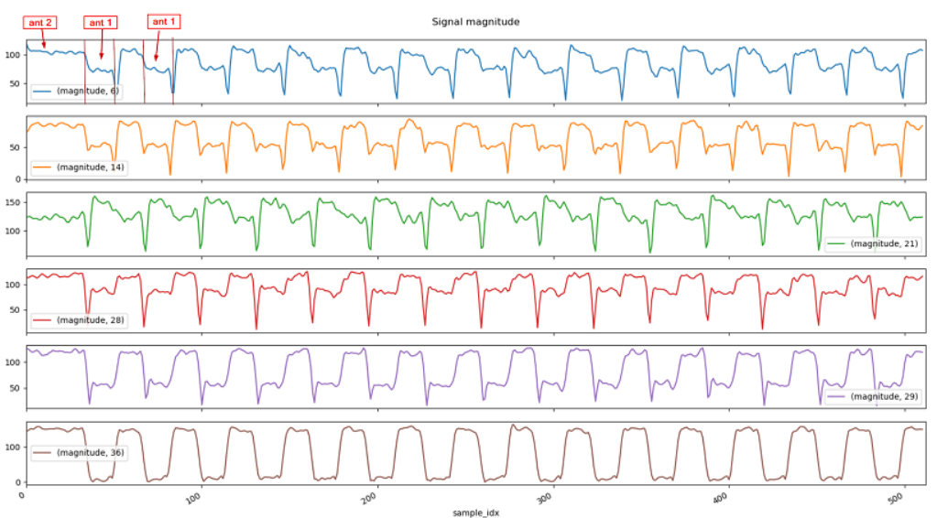
How can we use Compressed Sensing,
Compressed Sensing – Signal processing technique for efficiently acquiring and reconstructing a signal by finding solutions to underdetermined linear systems.
Now – We are getting angular samples which is suppose to be a flat value. ()
Another Possibility – Getting I/Q samples and approximating the values – Sudden Changes due to antenna switching.

Slide 12
My Plan for Next Week,
Understand and Resolve the Issue with Multi-Slaves
Finish and Printout a suitable 3D Model for Antenna Board
Homograph Matching – Test
Work on compressed sensing part if possible
Any Expectations?

